Slide 1
A beginner’s guide to Data Analytics: Course Intro + Bootstrap Notions!
Damian A. Tamburri, Ph.D.

Slide 2
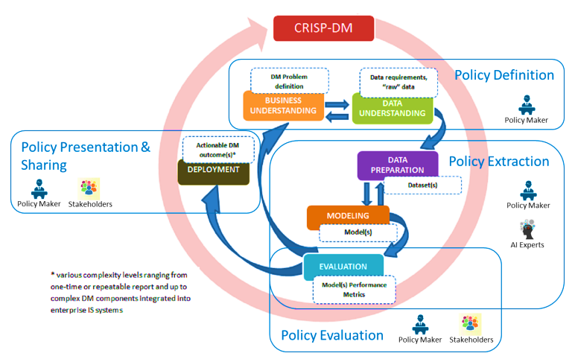
CRISP-DM from a BI Perspective

Slide 3
Main steps in a BI/Data Analytics Project
Define the goals:
Business and data mining experts together have to define the goals;
Each goal must be defined with measurements for success;
Obtain the models:
Apply data mining algorithms;
Preprocessing is important!
Evaluate results:
ascertain the value of an object according to specified criteria, operationalised in terms of pre-specified measures;
Deploy:
Decide patterns and models that can be deployed;

Slide 4
1. Define the goals
Distinguish between :
Data Mining goals
Business goals
How do we translate?
Increase the lifetime value of valuable customers
¿?
¿?
¿?
Classification
Estimation
Association

Slide 5
Business Understanding in the CRISP-DM* Process
Business Understanding
Determine Business Objectives
Background
Business Objectives
Business Success Criteria
Assess Situation
Inventory & Resources
Reqs, Assumptions &Constraints
Risks & Contingencies
Terminology
Costs & Benefits
Determine Data Mining Goals
Data Mining Goals
Data Mining Success Criteria
Produce Project Plan
Project Plan
Initial Assessment of Tools & Techniques
* Cross-Industry Standard Process for Data Mining:CRISP-DM

Slide 6
1.1 Determine Business objectives and success criteria
Not only business objectives have to be established but measures in order to be able to evaluate the results
Business objectives:
What is the customer's primary objective?
Increase the number of loyal customers
Selling more of a certain product
Have a positive marketing campaing
Business success criteria:
What constitutes a successful outcome of the project?
Objectives measures so that the success can be established
ROI

Slide 7
1.2 Costs & Benefits
Perform a cost-benefits analysis
Compute the benefits of the project
Which measures do we have?
ROI
APEX
OPEX....
Compute the costs of the project (equipment, human resources...)
Which methodology do we have?
COCOMO for sortware engineering part
Quantify the risk that the project fails
Knowledge not available
Data Not available
Proper tools

Slide 8
Data Mining Estimation Model
Establishing a parametrical estimation model for Data Mining (Marban’03)
DMCOMO
(Data Mining COst MOdel)

Slide 9
Data Mining Cost Estimation
Main factors in a Data Mining project
Data Sources (number, kind, nature, …)
Data mining problem to be solved (descriptive, predictive, …)
Development platform
Available tools
Expertise of the development team
Drivers
Data Drivers
Model Drivers
Platform Drivers
Tools and techniques Drivers
Project Drivers
People Drivers

Slide 10
1.3 Data Mining: Goals and Success
Data mining goals:
Translate the customer's primary objective into a data mining goal, e.g.
Loyalty program translated into segmentation problem
Decreasing the attrition rate transformed into classification problem
Data mining success criteria:
Determine success in technical terms
Translate the notion of sucess into confidence, support and lift and other parameteres
Determine de cost of errors
How do we make the translation?

Slide 11
Methodology
Which is the methodology to be followed to translate business objectives into data mining objectives?
Unluckily, there is no such methodology. First we have to solve:
How a business objective is expressed?
What is a data mining goal?
How are data mining goals achieved?
Which are the requirements of data mining functions?
In order to describe everything in a standard way:
Conceptualize the problem

Slide 12
Conceptualization in other disciplines
Data Bases:
E/R diagrams
Independent of the domain
A tool for business understanding and for data base designer
Translation from E/R to implementation
External view 1
External view n
Conceptual Schema
Internal Schema

Slide 13
3-level Architecture for DA
Business problem
Business problem
Requirements of algorithms will
be solved at this level
Conceptual Schema
Internal Schema
Tools requirements to be solved here
SAS, WEKA, Clementine…

Slide 14
Elements to conceptualize
Elements to be taken into account:
Data:
Quality from data mining point of view
Adequateness for the problem
Classification for data mining purposes
Knowledge:
Related to the process being analyzed
Related to the data used
People
Owners of data
Experts in the process
Data mining problems requirements
Data mining methods requirements

Slide 15
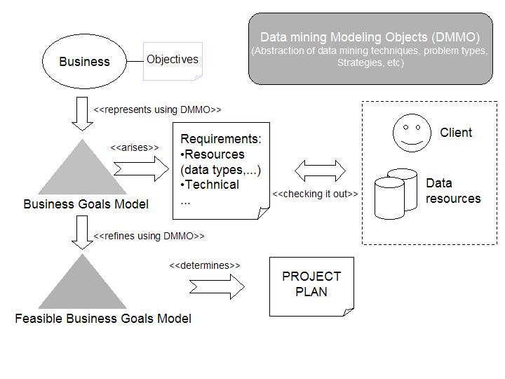
Proposed process

Slide 16
DAMO
Data Analytics Modelling Objects:
Data
Knowledge
Constraints of data and applications
Data Mining objects
Algorithms
Measures
Methods
Bridge the gap between data miners and business users;

Slide 17
Is the data adequate for analysis?
The adequateness of the data is analyzed taking into account goals to fulfill;
Data & expert knowledge can be transformed so that just by being the input of a certain data mining algorithm will produce the required patterns;
Quality of the data, in this context:
is not only related to the technical quality;
proper model, percentage of null values;
meaning of the attributes;
Where each piece of data comes from;
relationship among data;
how the data fulfills data mining requirements

Slide 18
2. Data Mining == obtain models
Apply data mining process model
Associated problems solved by the 3 layers architecture:
Comparison of approaches
Evaluate costs
Pros and cons of approaches
Only experience or a conceptualization can help
The conceptual model will help to establish the process to obtain each feasible model.
Requirements and transformations implicit in the model

Slide 19
2.1 Determine type of problem
What are data mining problems?
Classification
Estimation
Association
Segmentation
In the conceptual model requirements for each type will be settled
Notes:
what is needed to complete the puzzle

Slide 20
3. Evaluate results*
Evaluation: the act of ascertaining the value of an object according to specified criteria, operationalised in terms of measures;
Object= model already obtained;
Criteria and Measures and has to do with goals;
Evaluation requires a well-defined notion of success, which must be in place before
the evaluation takes place
the data mining phase starts
any work with the data starts
i.e. already during the business understanding process;
Here once again conceptualization plays its role;
* [Spilipopou, Berendt]

Slide 21
Evaluation in the CRISP-DM Process
The CRISP-DM process is:
a never-ending circle of iterations;
a non-sequential process, where backtracking at previous phases is usually necessary;
In each sequential instantiation evaluation takes place:
But it is a cycle;
In all the iterations all the steps should be revisited;
Results have to be evaluated!!
Business Understanding
Business Understanding
Data Understanding
Data
Preparation
Modeling
Evaluation
Deployment

Slide 22
4. Deployment
All the models that have possitive evaluation can be deployed
For measurements of success to trust deployment has to follow rules established at the beginning of the project
The real evaluation has not yet been performed

Slide 23
A quick example, Netflix!
Find recommendations for *all* customer profiles
Find opportunities for new series/movies...
Notes:
datamburri@unisannio.

Slide 24
A quick example, Netflix!
Find recommendations for *all* customer profiles
Find opportunities for new series/movies...

Slide 25
A quick example, Netflix!
Find recommendations for *all* customer profiles
Find opportunities for new series/movies...

Slide 26
Ratings Data
17,700 movies
1 | 3 | 4
 | 3 | 5 |  |  | 5
 |  | 4 | 5 |  | 5
 |  | 3
 |  | 3
2 |  |  | 2 |  | 2
 |  |  |  | 5
 | 2 | 1 |  |  | 1
 | 3 |  |  | 3
1
480,000
users

Slide 27
Rating Data
100 million ratings (matrix in prev slide is 99% sparse)
Rating = [user, movie-id, time-stamp, rating value]
Generated by users between Oct 1998 and Dec 2005
Users randomly chosen among set with at least 20 ratings
Small perturbations to help with anonymity

Slide 28
A quick example, Netflix!
Find recommendations for *all* customer profiles
Find opportunities for new series/movies...

Slide 29
Ratings Data
17,700 movies
1 | 3 | 4
 | 3 | 5 |  |  | 5
 |  | 4 | 5 |  | 5
 |  | 3
 |  | 3
2 |  |  | ? |  | ?
 |  |  |  | ?
 | 2 | 1 |  |  | ?
 | 3 |  |  | ?
1
480,000
users
Test Data Set
(most recent ratings)

Slide 30
Ratings Data
17,700 movies
1 | 3 | 4
 | 3 | 5 |  |  | 5
 |  | 4 | 5 |  | 5
 |  | 3
 |  | 3
2 |  |  | ? |  | ?
 |  |  |  | ?
 | 2 | 1 |  |  | ?
 | 3 |  |  | ?
1
Hold on… what is this?
480,000
users
Test Data Set
(most recent ratings)

Slide 31
Meet the ML Canvas!

Slide 32
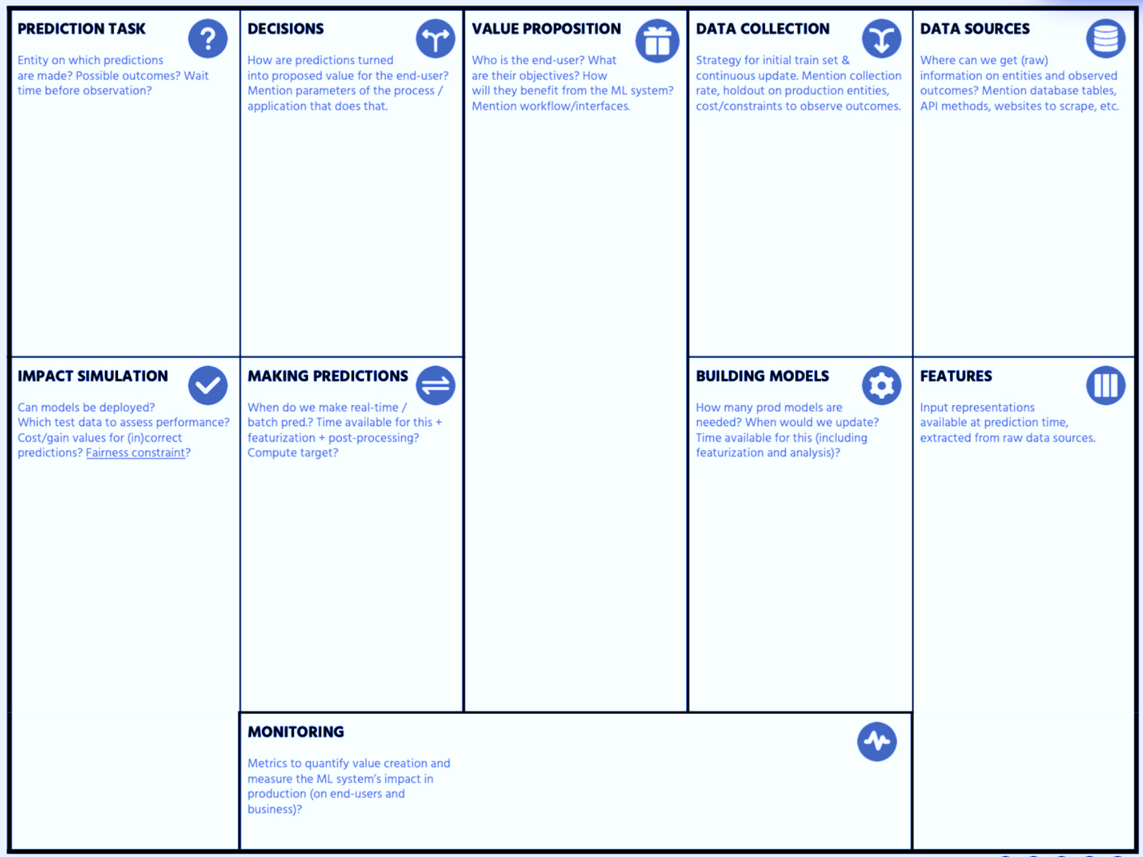

Slide 33

In Practice…
“Machine learning is about predicting the future based on the past.”
-- Hal Daume III

Slide 34
So, Machine Learning is about…
“Machine learning is about predicting the future based on the past.”
-- Hal Daume III
past
future
predict
learn
Training
Data
model/
predictor
Testing
Data
model/
predictor

Slide 35
Disclaimer! Data Analytics, a.k.a...
data mining: e.g., machine-learning applied to “databases”, i.e. collections of data
inference and/or estimation: ML in statistics to approximate curves based on more and more data
pattern recognition: ML to identify patterns in engineering
signal processing: same as above but in electrical engineering
Optimization: correct behavior based on previous experience

Slide 36
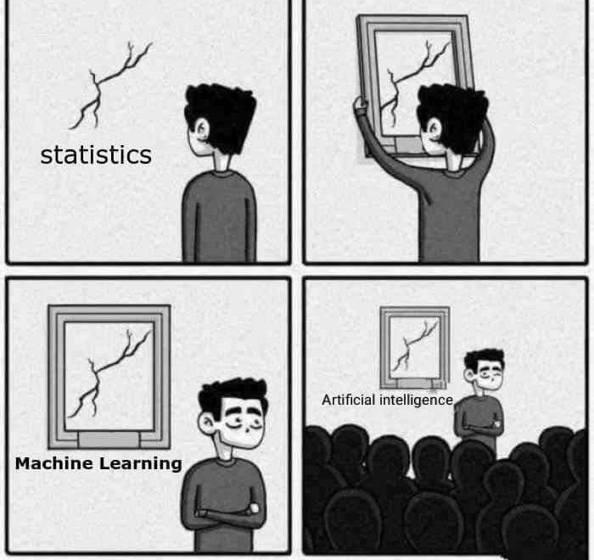
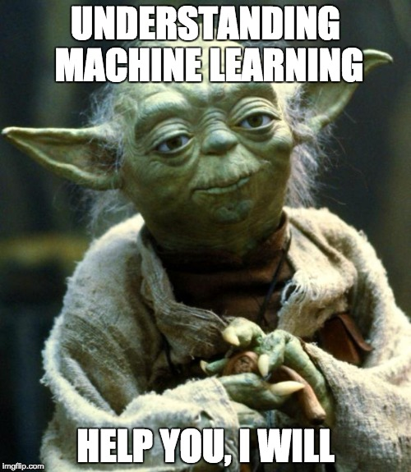
The best way to explain ML

Slide 37
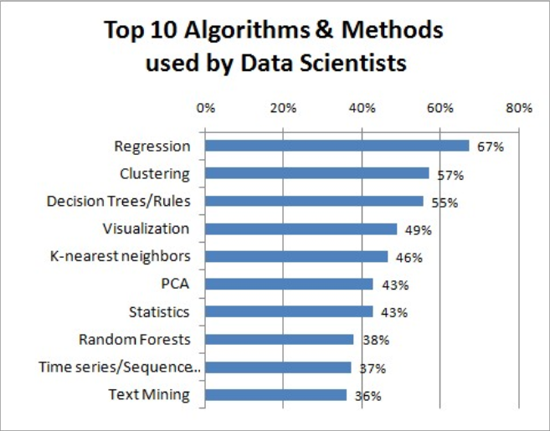
The best way to explain ML

Slide 38
Machine Learning, let’s dive in!
data mining: machine learning applied to “databases”, i.e. collections of data
inference and/or estimation: ML in statistics to approximate curves based on more and more data
pattern recognition: ML to identify patterns in engineering
signal processing: same as above but in electrical engineering
Optimization: correct behavior based on previous experience

Slide 39
Here’s a good question...
Assume you’re a regular human...
You’re iterating over and over again on the previous 3 exercises...
What should be constant in your exercise?
1.
2.

Slide 40
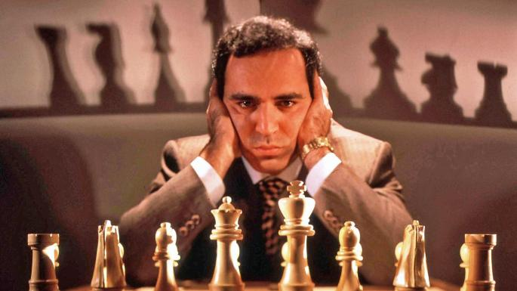
Here’s a good question...
Assume you’re a regular human...
Meaning that you’re not THE Librarian, nor THE Doctor, nor Garry Kasparov…

Slide 41
Back to our exercise...
Assume you’re a regular human...
You’re iterating over and over again on the previous 3 exercises...
What should be constant in your exercise?
1.
2.

Slide 42
Here’s a hint...
Natural lang.
vision
effectors
input
Knowledge
representation
learning
planning
reasoning

Slide 43
Here’s a good question...
Assume you’re a regular human...
You’re iterating over and over again on the previous 3 exercises...
What should be constant in your exercise?
1. Learning!
2.
Create new knowledge by processing available data – new knowledge is to be checked against future instances of same phenomenon

Slide 44
Here’s a good question...
Assume you’re a regular human...
You’re iterating over and over again on the previous 3 exercises...
What should be constant in your exercise?
1. Learning!
2. Improving!
Reduce the amount of errors made with respect to testing of created knowledge against new instances of same phenomenon

Slide 45
Here’s a good question...
Assume you’re a regular human...
You’re iterating over and over again on the previous 3 exercises...
What should be constant in your exercise?
1. Learning!
2. Improving!
When you’re doing it, it’s Human Learning...

Slide 46
Here’s a good question...
Assume you’re a regular human...
You’re iterating over and over again on the previous 3 exercises...
What should be constant in your exercise?
1. Learning!
2. Improving!
When you’re doing it, it’s Human Learning...
When a machine does it, it’s Machine Learning! ☺

Slide 47
In summary…
Assume you’re a regular human...
You’re iterating over and over again on the previous 3 exercises...
What should be constant in your exercise?
1. Learning!
2. Improving!
Use clever strategies and algorithms, combine them with good data and statistics

Slide 48
In summary…
Assume you’re a regular human...
You’re iterating over and over again on the previous 3 exercises...
What should be constant in your exercise?
1. Learning!
2. Improving!
Use clever statistical indices (F-Measure, AUC-ROC) to measure the overlaps between ML prediction and expected result

Slide 49
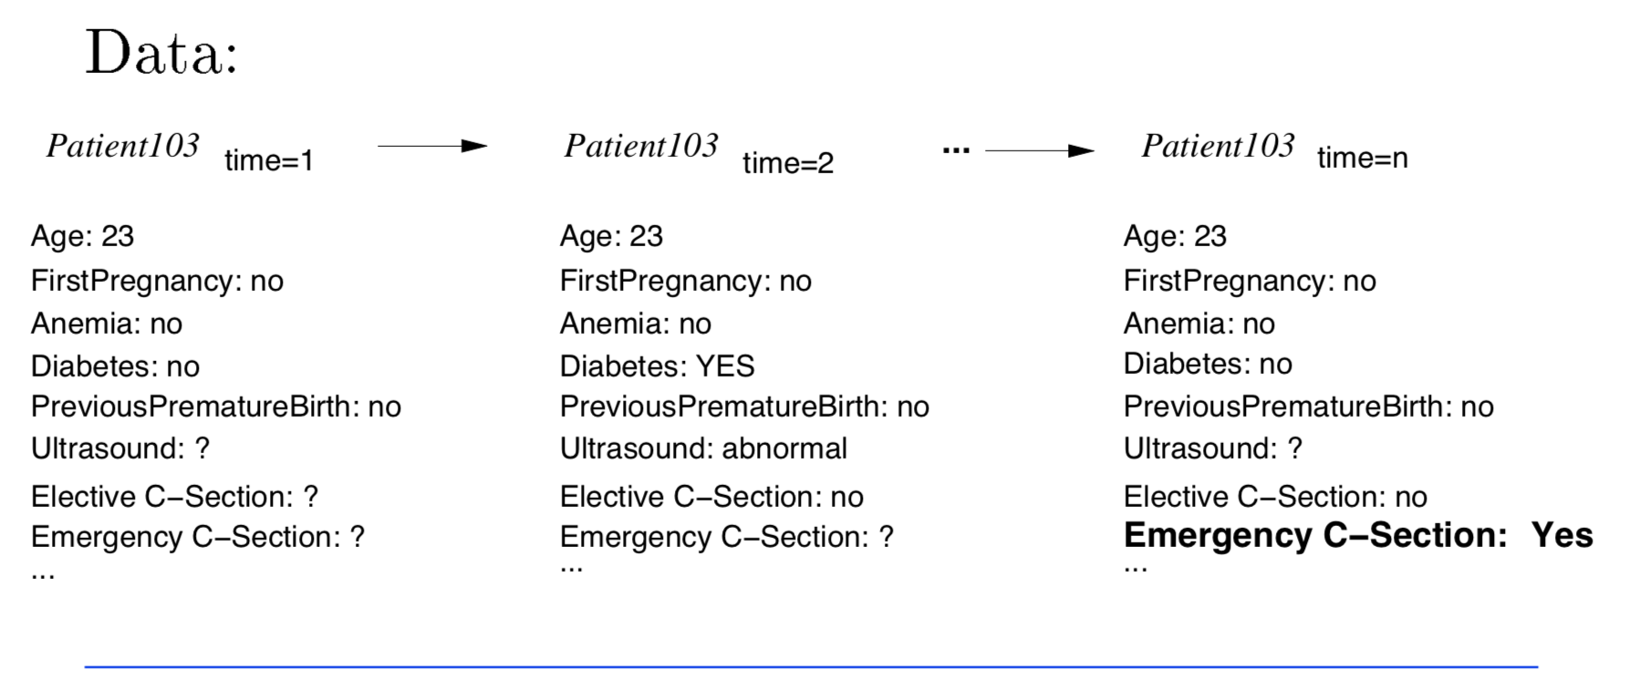
Typical Data-Mining Task
Medical records

Slide 50
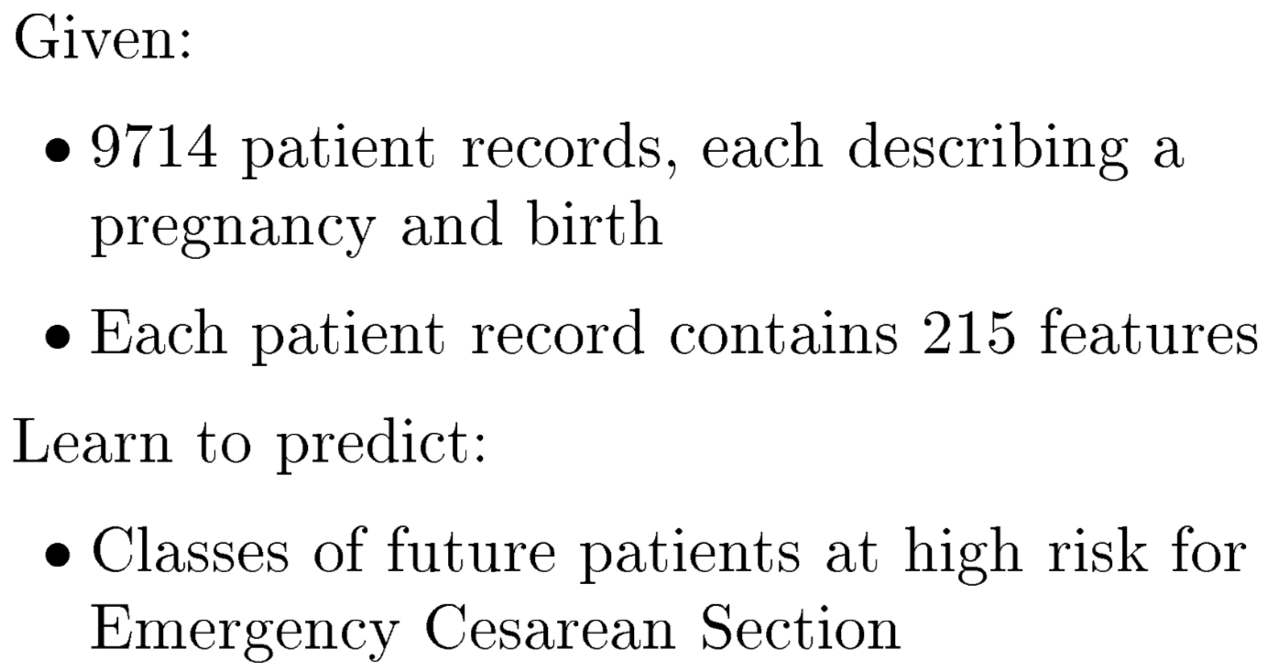
ML Task involved in this case…
* ML Task *

Slide 51
Back to our Examples...
C-Section “Learning” == Text Classification!
Task T
Assigning medical texts to a set of predefined risk categories
Performance measure P
Precision and recall of each category
Training experiences E
A database of texts with their corresponding categories

Slide 52
First, let’s take a step back...
C-Section “Learning” == Text Classification!
Task T
Assigning medical texts to a set of predefined risk categories
Performance measure P
Precision and recall of each category
Training experiences E
A database of texts with their corresponding categories
How about Disease Diagnosis?
How about Chess Playing?
...

Slide 53
Unranked evaluation: Precision and Recall
Sec. 8.3
Precision: fraction of retrieved docs that are relevant = P(relevant|retrieved)
Recall: fraction of relevant docs that are retrieved
= P(retrieved|relevant)
Precision P = tp/(tp + fp)
Recall R = tp/(tp + fn)
 | Relevant | Nonrelevant
Retrieved | tp | fp
Not Retrieved | fn | tn
Notes:
Evaluation in information-retrieval
Other techniques and intro here: http://www.ics.uci.edu/~djp3/classes/2008_01_01_INF141/Lectures/Slides26.pdf

Slide 54
A combined measure: F
Sec. 8.3
Combined measure that assesses precision/recall tradeoff is F measure (weighted harmonic mean):
People usually use balanced F₁ measure
i.e., with β = 1 or α = ½
Harmonic mean is a conservative average
See CJ van Rijsbergen, Information Retrieval
Notes:
https://en.wikipedia.org/wiki/Harmonic_mean

Slide 55
F₁ and other averages
Sec. 8.3

Slide 56
Recap
ML (and in general, AI) constitutes “the study of how to make computers do things at which, at the moment, people are better”;
CRISP-DM is a model to structure the data-mining process behind, before, and after ML;
Different models exist and different approaches can be used…
the Data Scientist builds and executes a research agenda towards a proper experimentation;
the Data Engineer elicits a plan to obtain/curate/govern the data and eventually deploy/maintain/evolve the model;

Slide 57
Project Work: Delivery
IEEE 2-column format (PDF)
https://www.overleaf.com/latex/templates/ieee-conference-template/grfzhhncsfqn
Max 10 pages
Must include at least
Intro to problem (with references)
Specification of ML Canvas
Specs over CRISP-DM campaign
Background and related work (with references)
Related works on the same topic/approach/domain
Unused methodologies
Research/solution design
Dataset specification
Data & Feature engineering
Choice of modelling approach with rationale
Results
Explanation and outline of results
Plots to substantiate
Visualizations as opportune
Discussion
Conclusions

Slide 58

Questions?

